Slide 1
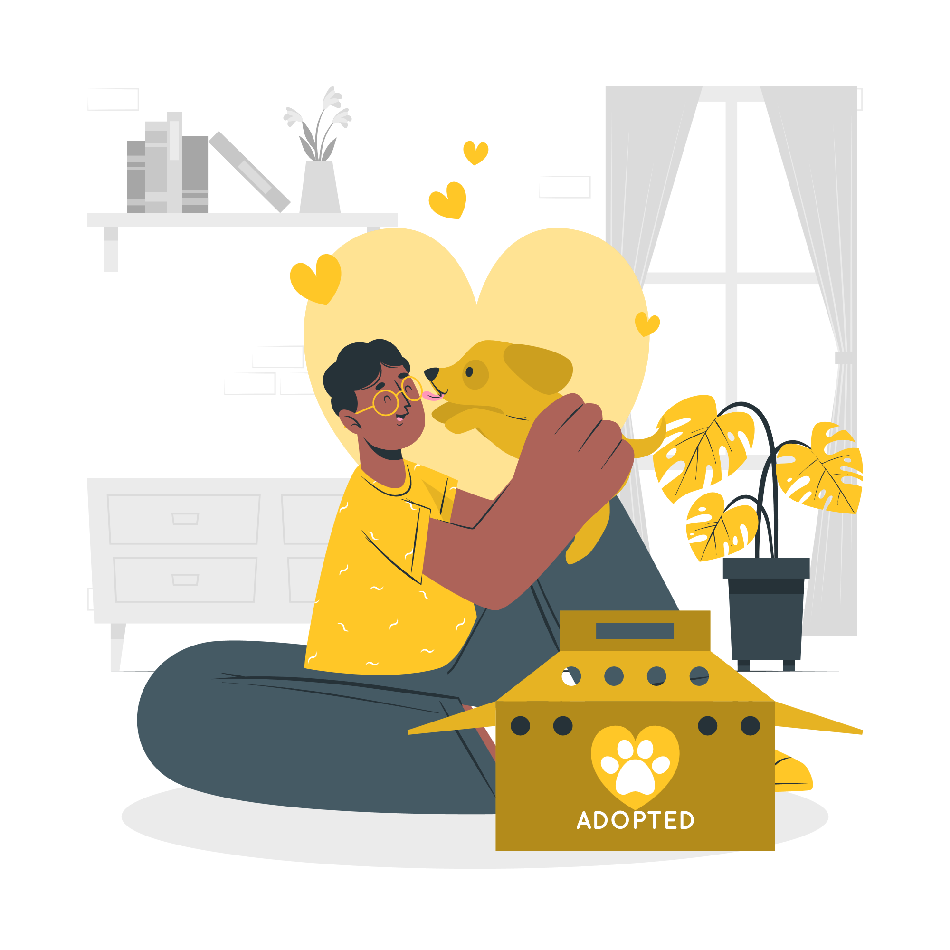
PETBOOK
Destination for Pet Lovers
Notes:
Good Morning everyone. We will be presenting our project idea, Petbook : destination for pet lovers.

Slide 2
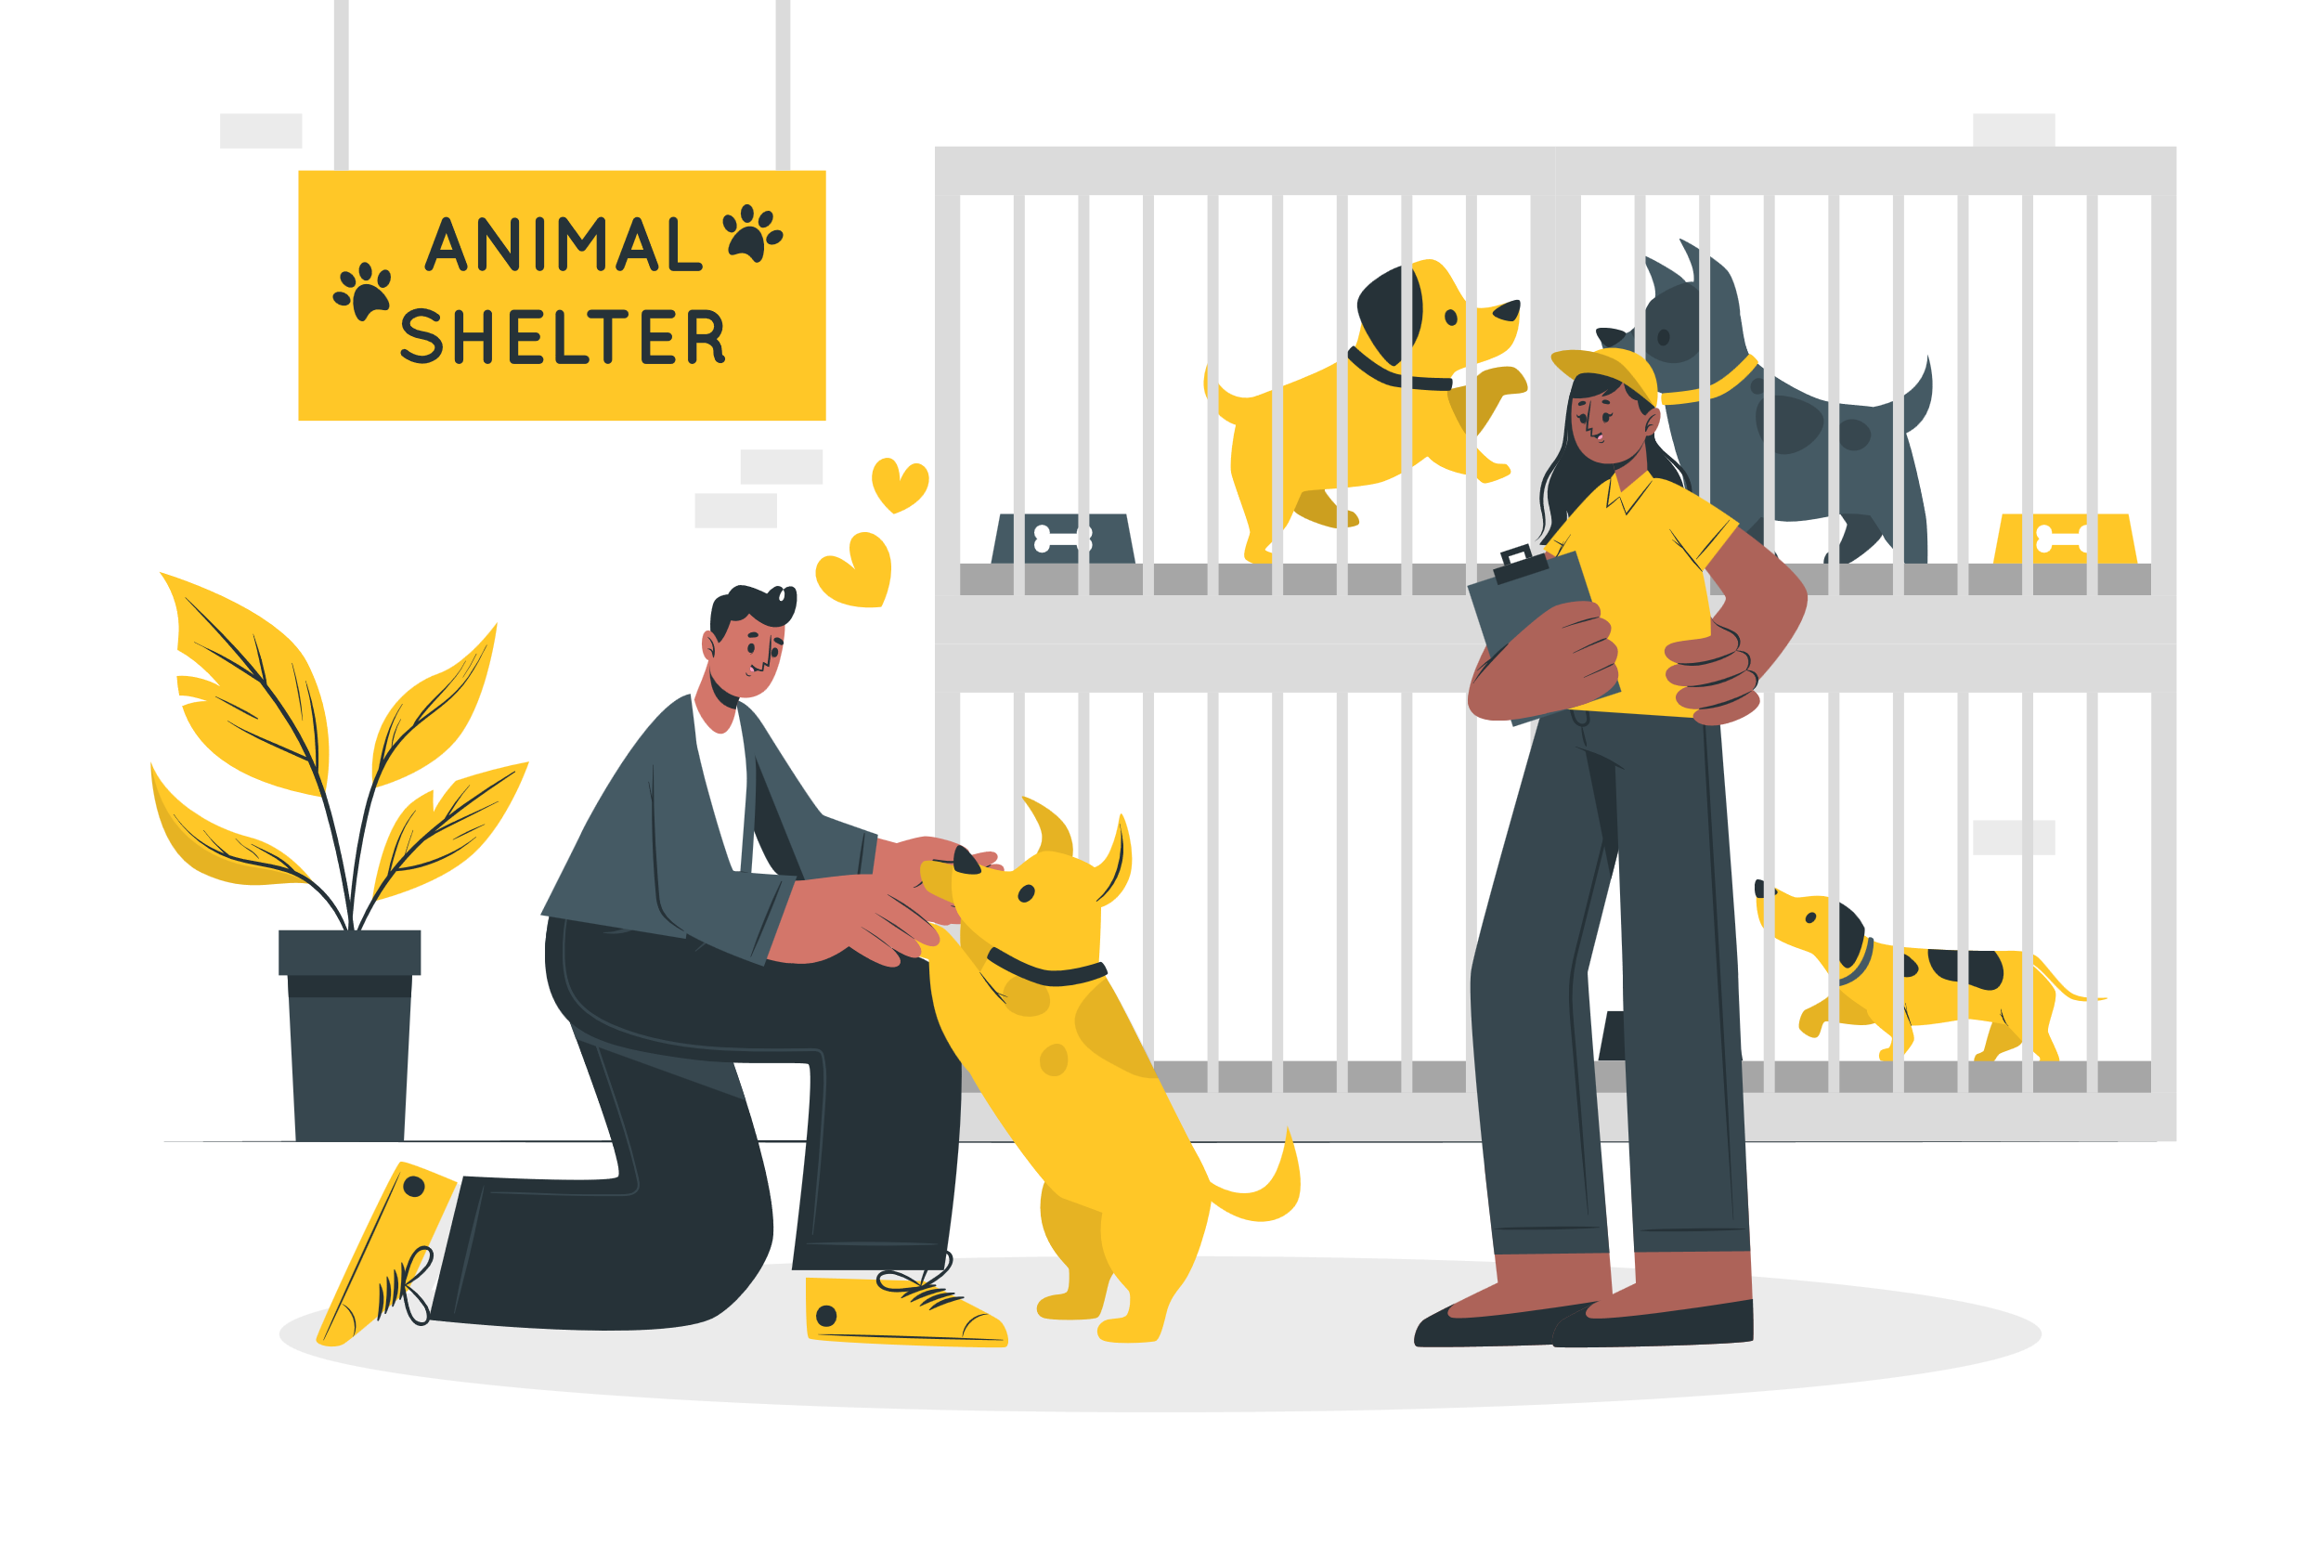
MAIN IDEA
Our aim is to make pet care and adoption/ buying hassle free.
Notes:
Our main idea is to make pet care and adoption/ buying hassle free.

Slide 3

PROBLEM
In general, store proprietors sell pets at exorbitant prices that are not negotiable.
Notes:
Users don’t have a lot of options and are unaware of the trustworthy sources. Store proprietors sell pets at exorbitant prices that are not negotiable.

Slide 4
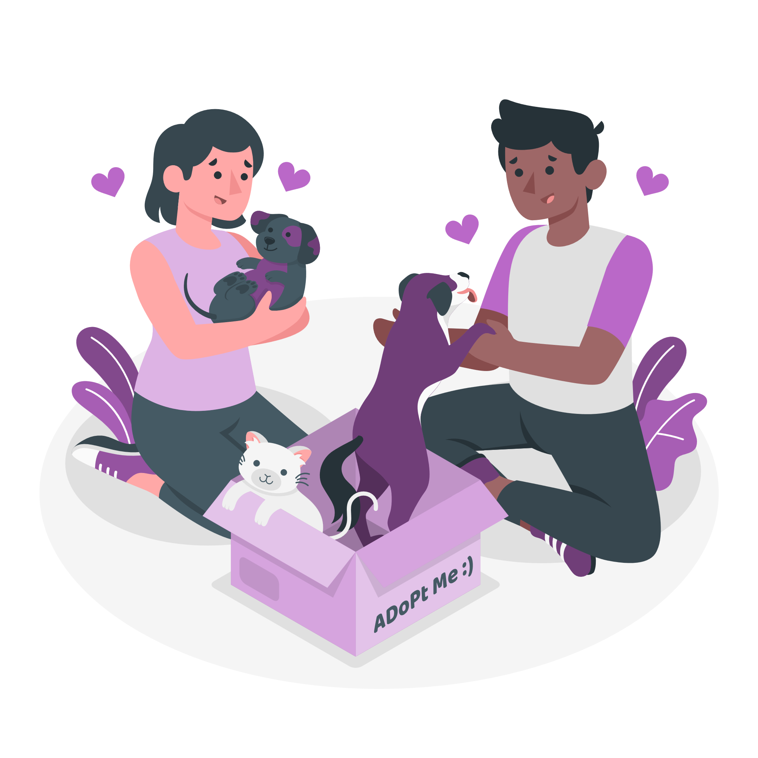
PROBLEM
If you are a foster parent and are unsure where to place your cherished pets ?
Notes:
Also, there is no way to find trustworthy people with experience for pet adoption.

Slide 5

PROBLEM
There is also the issue of pets going missing and being difficult to locate.
Notes:
Also, Pets often go missing and are difficult to locate.

Slide 6

PROBLEM
When you come across a lost pet and are unsure how to assist it, what do you do?
Notes:
People find a wandering pet and don’t know whom to approach.

Slide 7

PROBLEM
There is an upsurge in pet owners and their desire to have more pets these days. At the same time, they are oblivious to their pet’s needs.
Notes:
Pet owners are oblivious to their pet’s needs.

Slide 8

SOLUTION
Notes:
Our app provides solution for all these problem at the tap of your finger.

Slide 9
User Features
Buy/ Adopt a Pet:
Search for any pet by breed, species, and so on.
Perform a reverse image search.
Filter and sort by breed, availability distance, gender, and so forth.
Can communicate with the owner through text or phone.
Through AR graphics, they may see how the pet would seem with them.
Option to boost posts to reach wider public
View Lost and Found pets:
Send a notice to everyone in the proximity who is using the app.
Examine the Last Seen status.
Create a custom street flier to distribute on other platforms.
Claim your pet by contacting us through text or phone.
User has an opportunity to earn money by finding a lost pet.
Notes:
User can buy or adopt a pet, can search for a lost pet and report a lost pet if found.

Slide 10
User Features
Sell / Donate Pet:
Donate your pets with ease, since you may specify the radius of relocation for your pet.
Pet Care Tips:
All the most recent information about pet care tips and tricks.
Guide:
To assist individuals in making an informed decision regarding which pet to purchase/adopt.
Notes:
Users can also add a post for adoption. Our app provides a guide and caring tips for pets for pet owners.

Slide 11


Other Apps v/s PETBOOK
OTHERS
PETBOOK
Options to buy/adopt, posts for lost and found
Notifications to everyone in the vicinity to help find your pet faster
Additional advanced features
Either the apps have only lost pet or adopt functionality
Notes:
Petbook is one stop solution for all the needs of pet owners while other apps in the market provide only one of the functionality.

Slide 12
Additional Advanced Features
Users may see how pets will truly appear using AR graphics, which will help them in their decision.
AR
Reverse Image Search
Users may utilize this function to find a pet for them even if they aren’t sure what breed it is, which will make the search process easier.
PET NEWS
Users can stay updated with the latest news about pet caring tips
Notes:
Advanced features in our app include: augmented reality visuals for users to experience the pet in real time. With reverse image search, they can easily filter out their desired pets and with pet news they can take care of them.

Slide 13
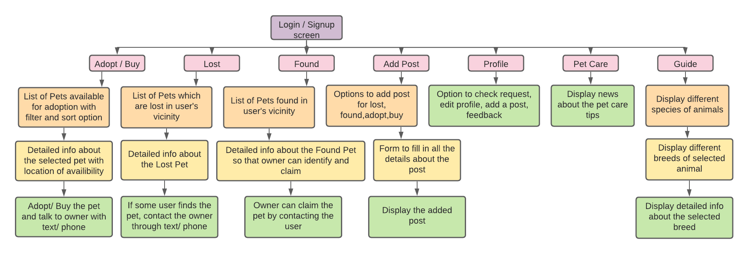
APP ARCHITECTURE
Notes:
Coming to the app architecture, login and signup screen are top level activities and displaying the detailed information about selected pets is our detailed level activity. The other activities which include list of breeds, profile, guide, pet care etc are category level activities.

Slide 14
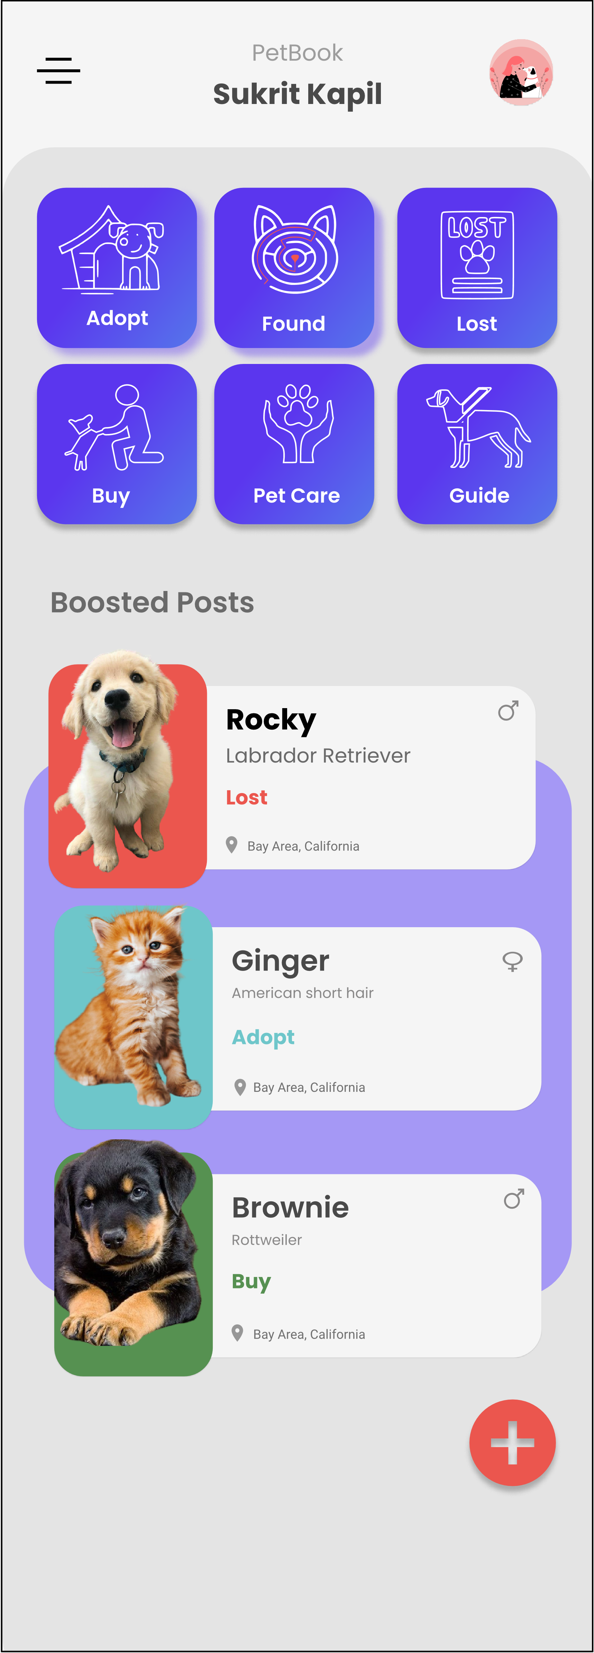
APP DESIGN
SECTIONS
NAV BAR
Navigate to pages like adopt, found etc.
To navigate through all the app and logout from the account
BOOSTED POSTS
Users posts who have opted for boosting will be displayed depending on the amount invested
ADD POST
To add lost/ found and adopt/ buying posts

Slide 15
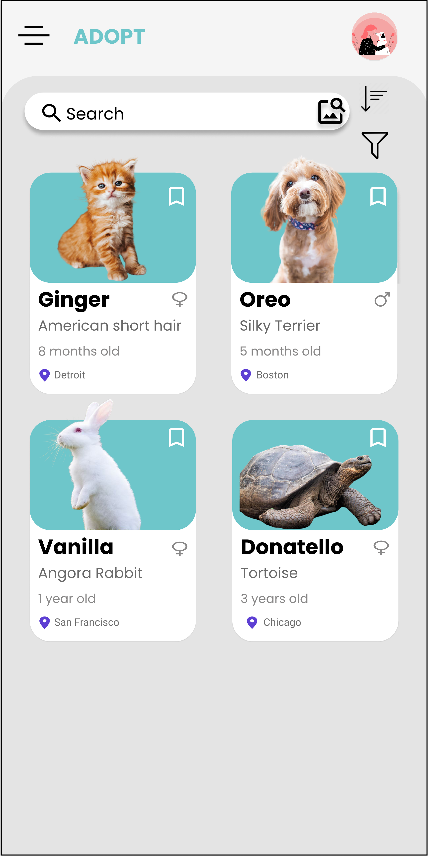
APP DESIGN
SORT
SEARCH BAR
Navigate to pages like adopt, found etc.
To search by name, breed, gender, age etc.
Option for Reverse Image Search
FILTER POST
Filter posts by breed, distance of availability, gender
ADOPTED POSTS
Users can see the image of the pet, its name, breed, age, gender and the location of availability. Upon clicking they can see detailed info about the pet

Slide 16
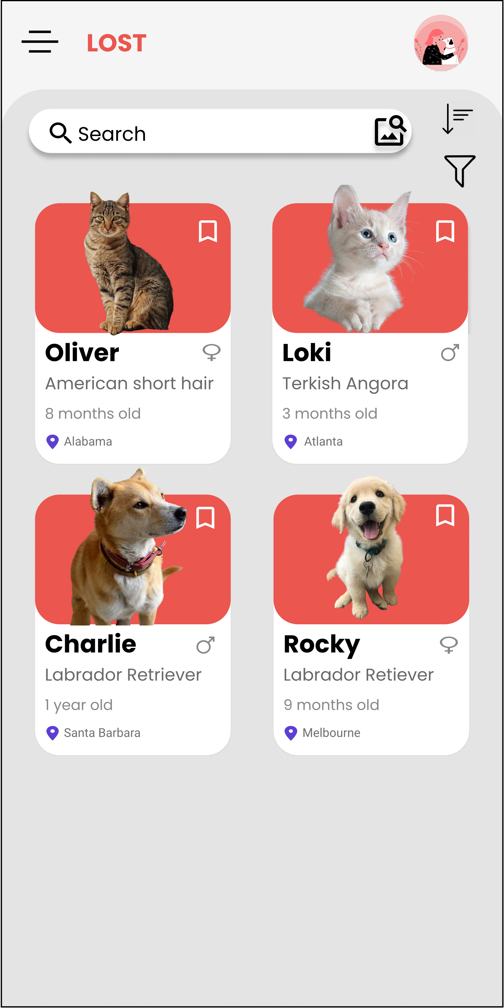
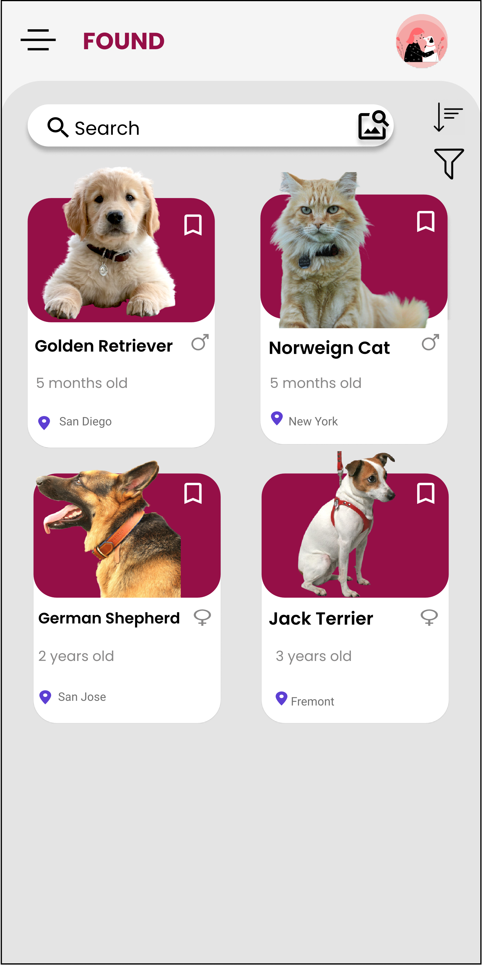
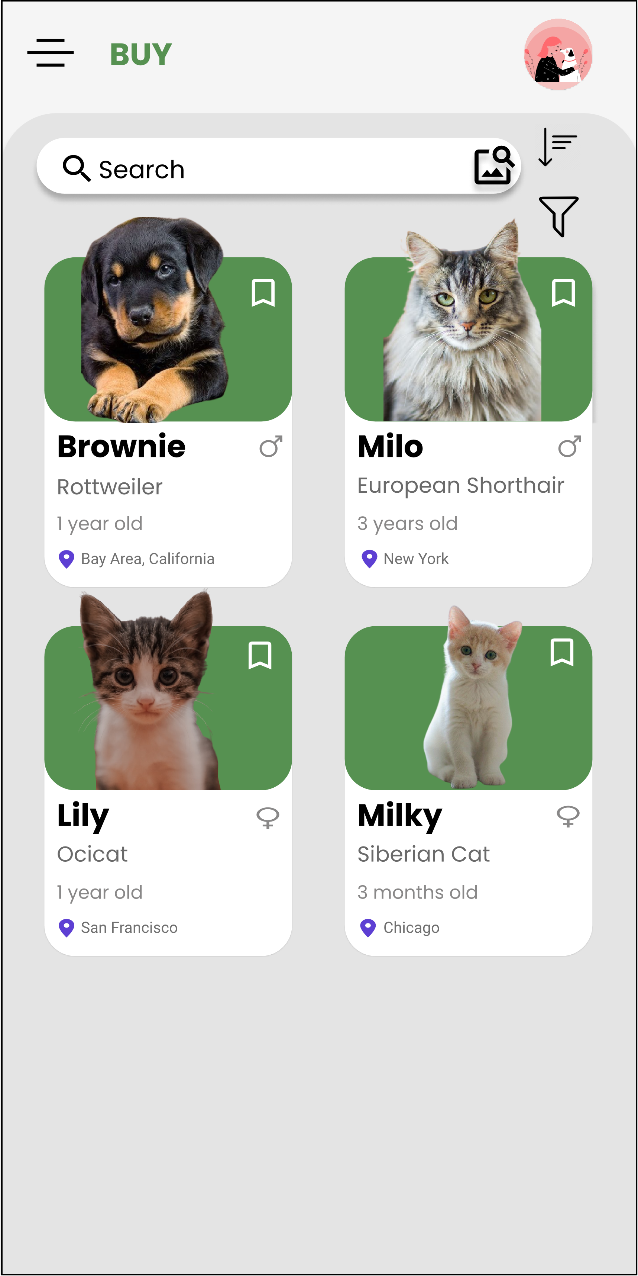
APP DESIGN

Slide 17
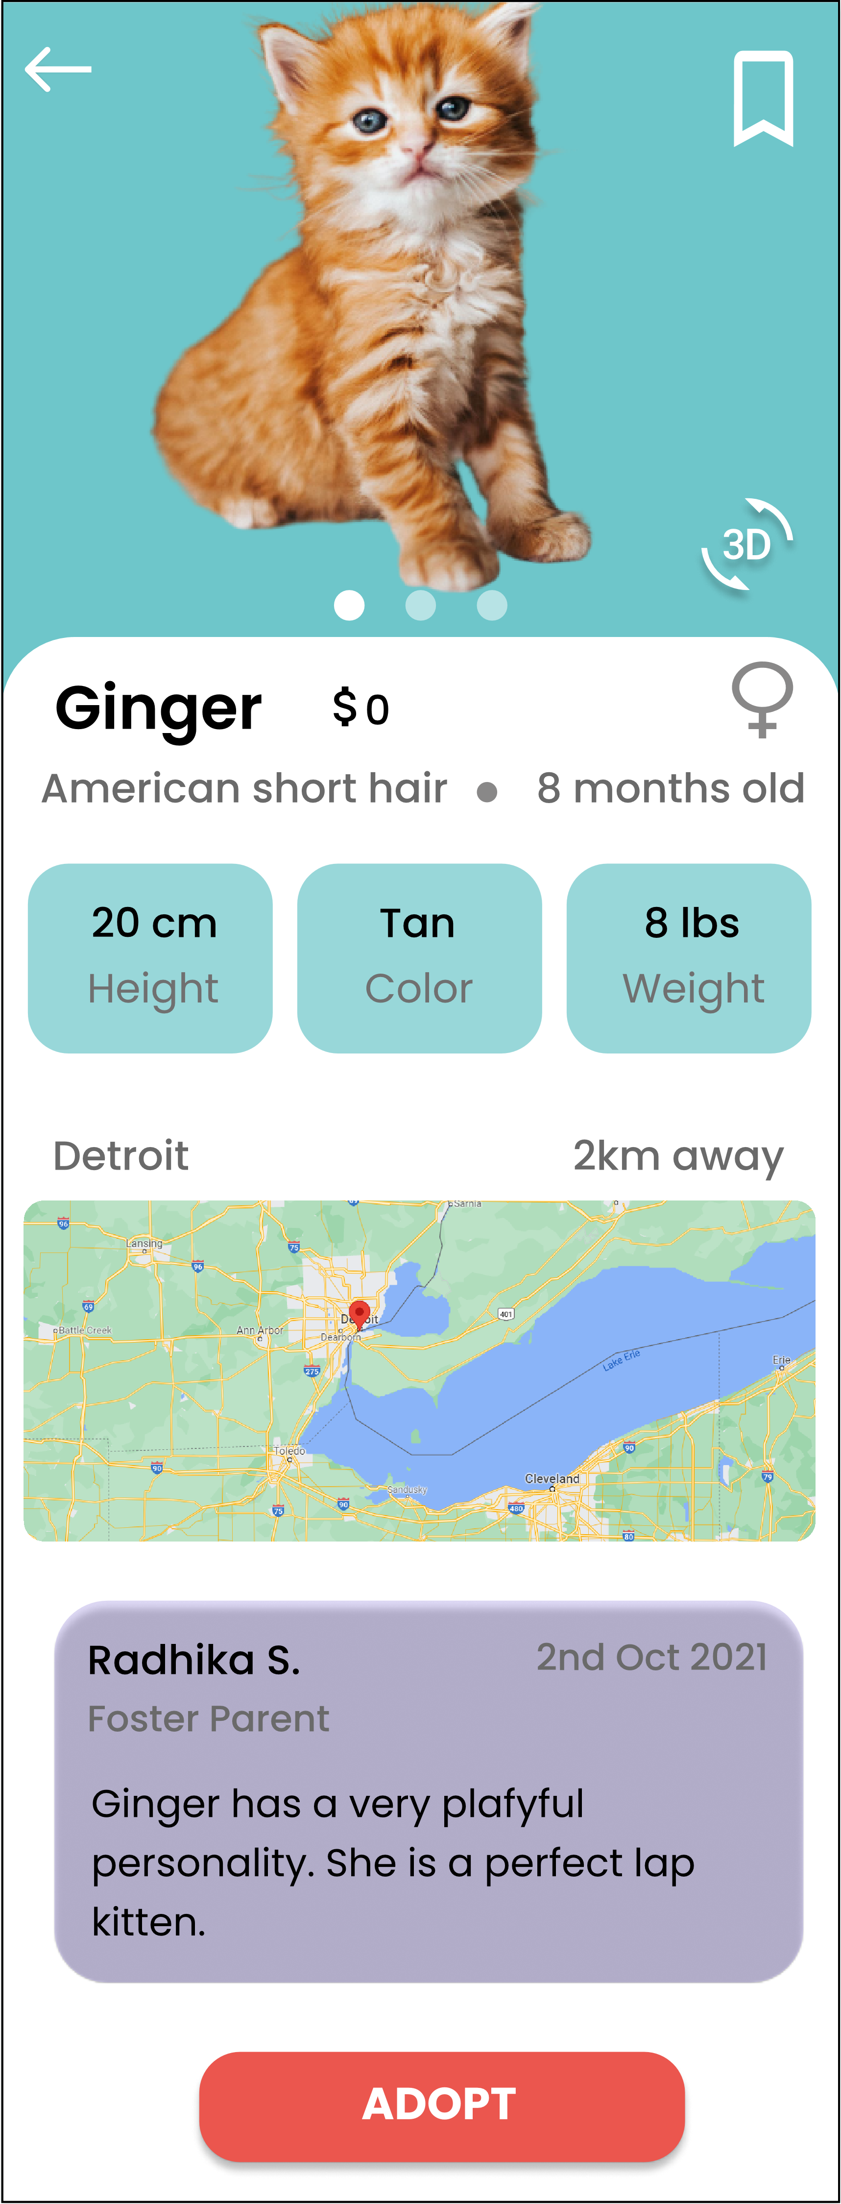
APP DESIGN
AR VISUALS
Tap to see how the pet will look in reality
GOOGLE MAP LOCATION
User can see the available location of the pet and get direction to the place
DETAILED INFO
User can see all the information regarding the pet to make an informed choice

Slide 18




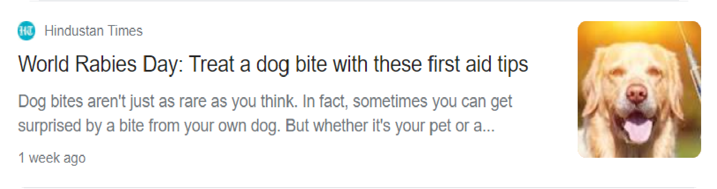

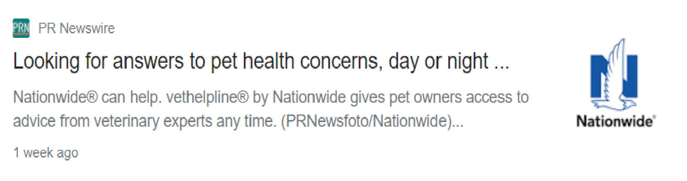
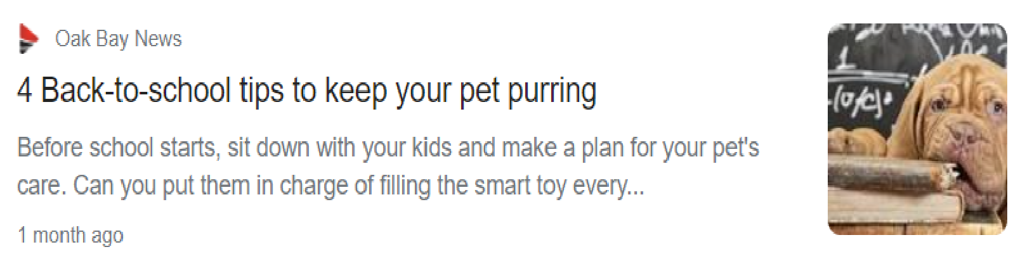
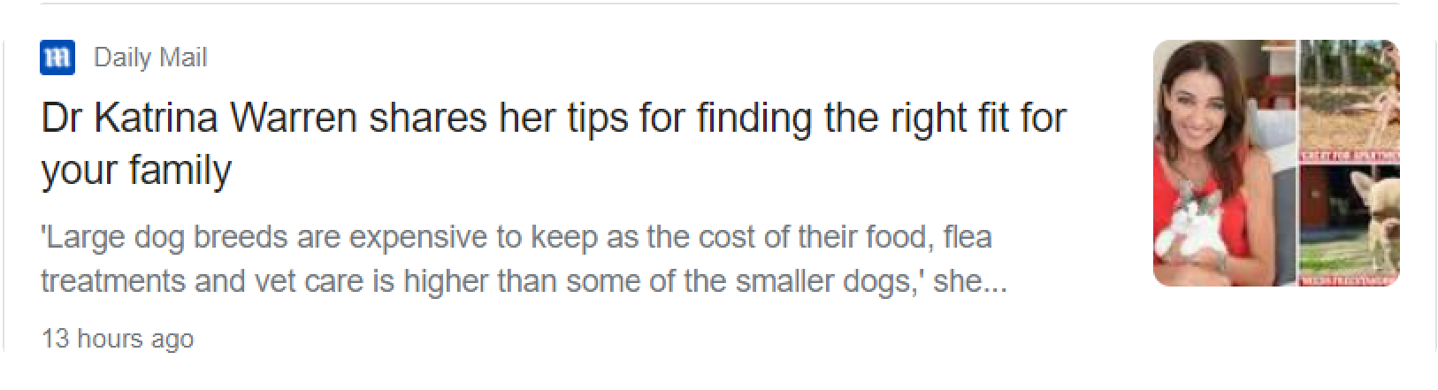
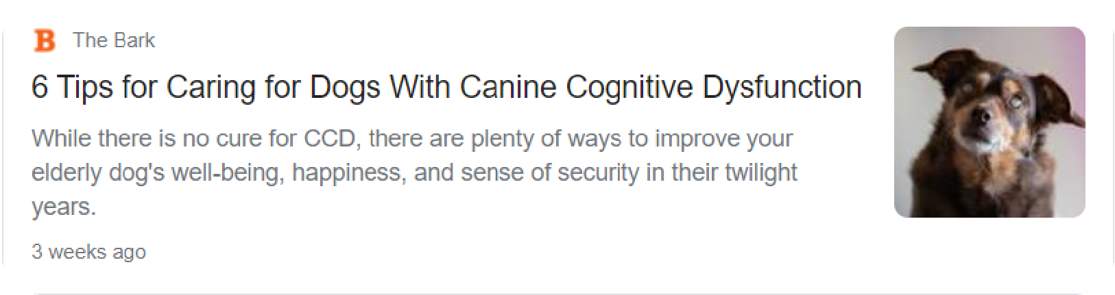
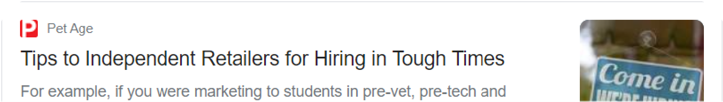
APP DESIGN
PET CARING TIPS
All latest updates on caring tips for all your pets

Slide 19
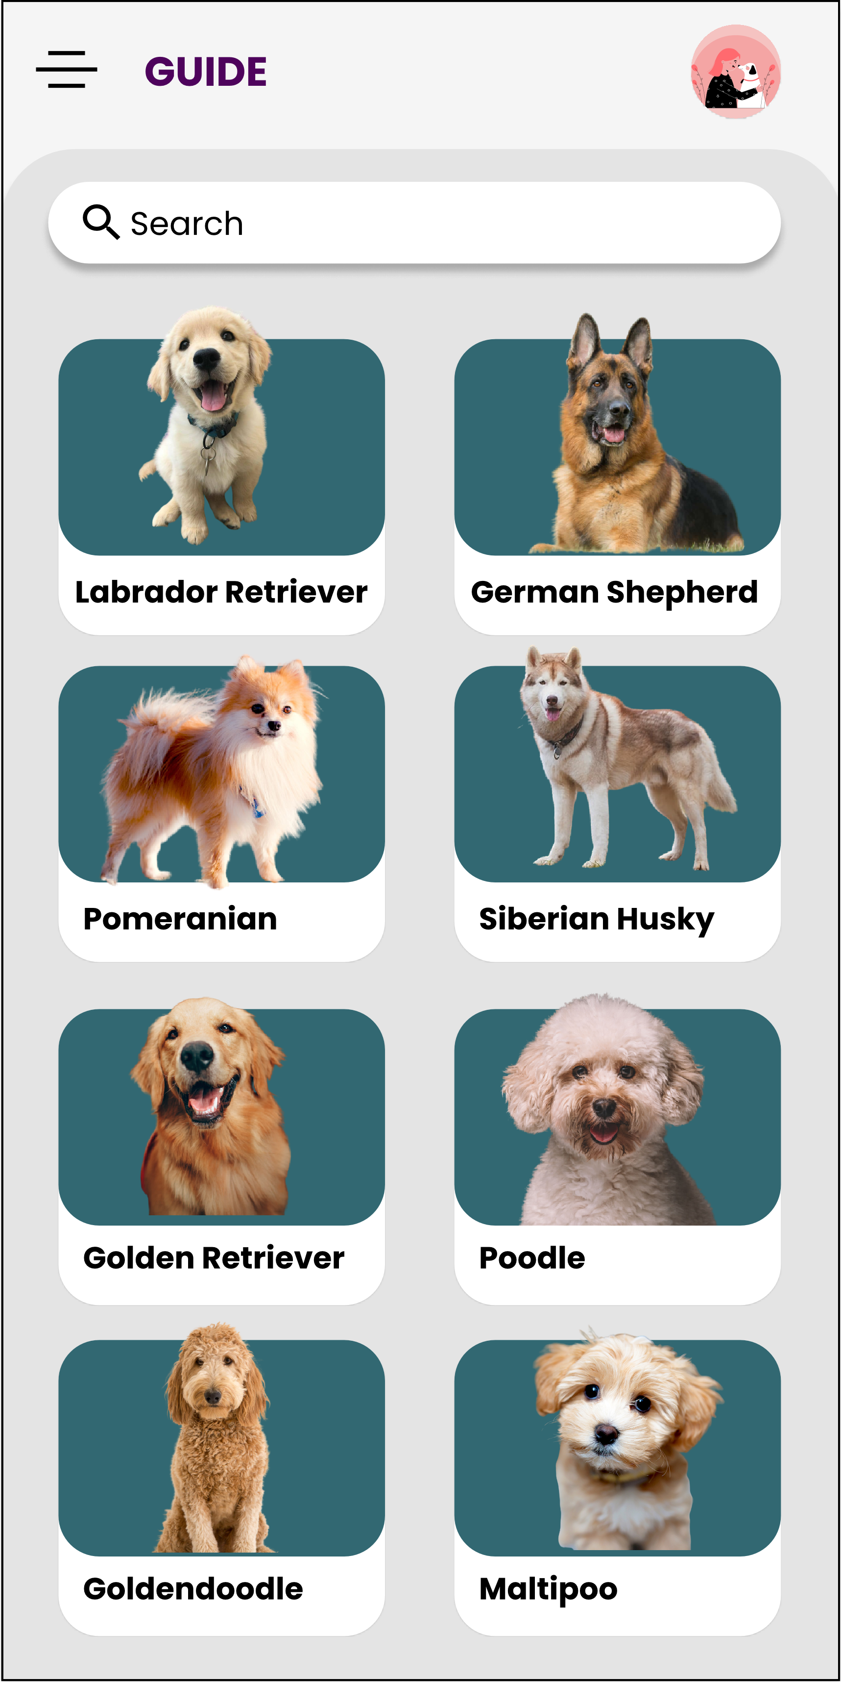
APP DESIGN
GUIDE
Check out all types of breeds and choose which one suits you better

Slide 20
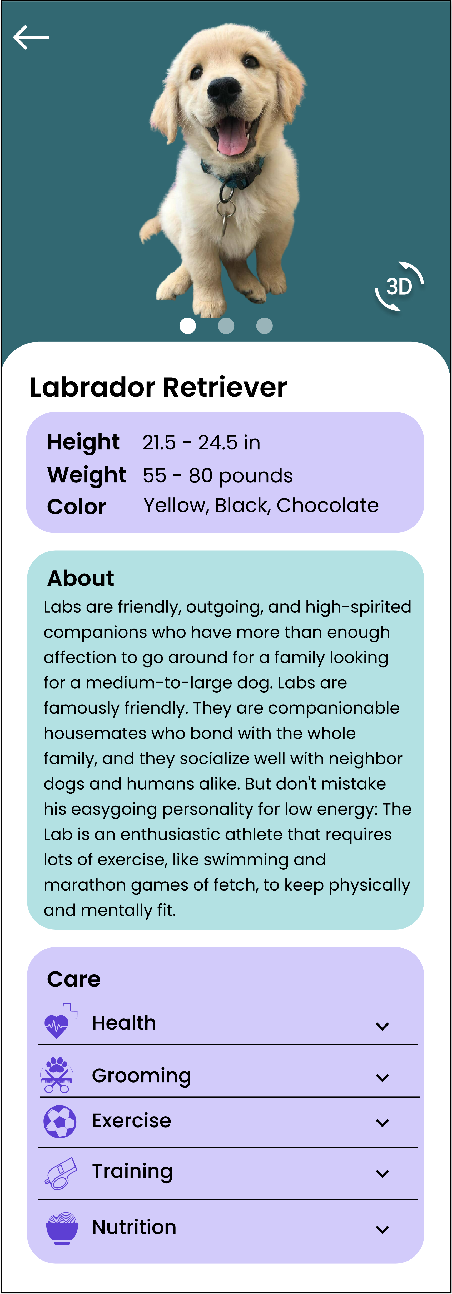
APP DESIGN
DETAILED INFO ABOUT THE BREED
All types of info including grooming, exercise for pet to make a wise decision.

Slide 21



APP DESIGN
PROFILE
REQUESTS
Approve lost and found claims as well as adopt and buy requests
ADD POST
FEEDBACK

Slide 22
PRODUCT DEMO
Notes:
This is how our user flow looks like:

Slide 23
Android Features
Backend
UI
Firebase
Material Design, Motion Layout, Animations, Navigation Menu
System Requirements
AR
Android 7.0 Nougat API 24
Steady internet connection
Google ARCore, Unity

Slide 24

Our Team
Notes:
Let’s introduce our team:

Slide 25





OUR TEAM
Radhika Sigtia
Sukrit Kapil
Sneh Lohia
Abdul Azeem
Notes:
I am -------.

Slide 26
WORK DIVISION
RADHIKA
SNEH
Backend development and handle ML related features
Work on AR and frontend development
SUKRIT
ABDUL
Backend connection and Data Management
Handle material design and motion layout along with UI

Slide 27

THANK YOU
Gift yourself a Pet

